Slide 1
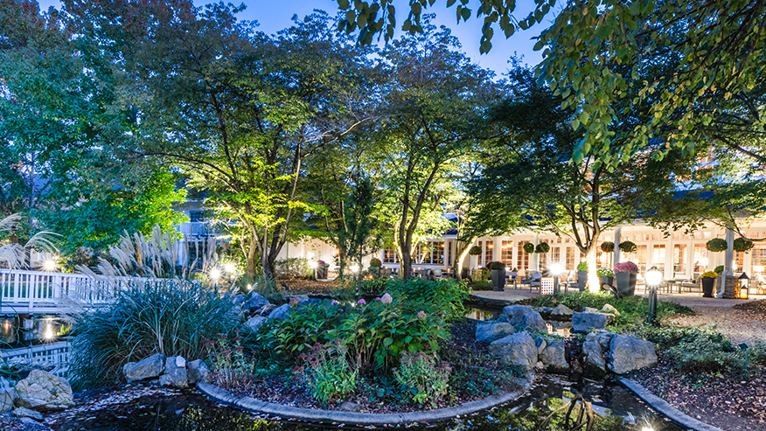
OOTF HCBS Advocacy Retreat 2024

Slide 2



The Grassroots Project: Supporting Disability Advocacy Nationally is funded by the Administration for Community Living and is administered by the Human Services Research Institute.

Slide 3
The project advances ACL’s efforts to support grassroots engagement in the implementation of the HCBS settings rule and ACL’s program priorities and focus areas, including:
Person-centered planning, consumer direction, and self-direction
Caregiver crisis
Health and safety in community living
HCBS settings rule
Civil Rights
Community integration

Slide 4
Goal of the Grassroots Projects
Together we will position the next generation of cross-disability, cross-generational and culturally diverse grassroots advocates as leaders and catalysts of systems change that hold states and / or providers accountable and responsive to input.
The project will support state and local advocacy and action coalitions in leveraging the ACL disability networks in each state and territory to advance quality community living.

Slide 5
National Partners
HSRI is working with nine subcontractors to form the National Advocacy and Action Coalition:
National Association of Councils on Developmental Disabilities
National Disability Rights Network
Association of University Centers on Disabilities
Autistic Self-Advocacy Network
Self-Advocacy Resource and Technical Assistance Center
Association of Programs for Rural Independent Living
National Council on Independent Living
National Paralysis Resource Center
National Associations of State Head Injury Administrators

Slide 6

The Ohio Olmstead Task Force’s
Home and Community Based Services (HCBS) Advocacy Retreat

Slide 7
Mission and Vision
OOTF's mission is to advocate, educate, and support change for all people with disabilities by ensuring their rights to participate in a thriving community life.
Ohioans with disabilities shall have access to inclusive, integrated, and person-centered services and support tailored to their individual needs to live independently in the community.
https://ohioolmstead.com/

Slide 8
Values
OOTF upholds these values to accomplish our mission and achieve our vision:
Serving people with disabilities by listening and leading
Empowering people with disabilities and their caregivers
Advocating for the rights of people with disabilities
Educating legislators and others about the needs of people with disabilities

Slide 9
Committees and Work Groups
Steering committee
Finance Committee
PR Committee
Direct care workforce workgroup
Housing advocacy Workgroup
Legislative Committee

Slide 10
Recent Activities and Wins
Multiple Legislative Advocacy Days at the Ohio Statehouse
  SB 202: anti-discrimination legislation for parents with disabilities
  Increased funding for Direct Care Workers in the last budget cycle
Carer Event 2023 at the Ohio Statehouse
We provide public comments on various rule changes from state agencies, written and in-person testimony on disability related legislation
Speaking engagements:
  Accessible Housing Conferences
  Disabled Women Make Art Event: Celebration of the Olmstead Decision
Partner with Ohio’s P&A and the CILs to host legislative town halls connecting advocates with their local and state policymakers
REVUP funding to discuss voting at various Youth Leadership Forums (YLFs) to increase voting education among youth
Working on policy around self-direction with the Medicaid and Aging Departments
Working with legislators to create a long-term study commission on the care crisis and the elimination of sub-minimum wage for people with disabilities

Slide 11
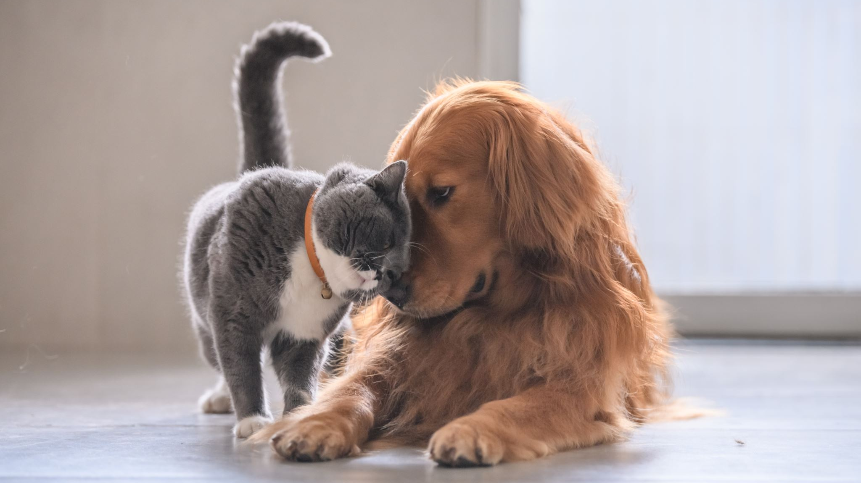
Introductions - group activity
1. Your name
2. Your title and where you work
3. Pronouns
4. Which dog or cat do you feel like? Why?
5. Why do you enjoy advocacy work?
6. What is one area of advocacy you're very passionate about?

Slide 12
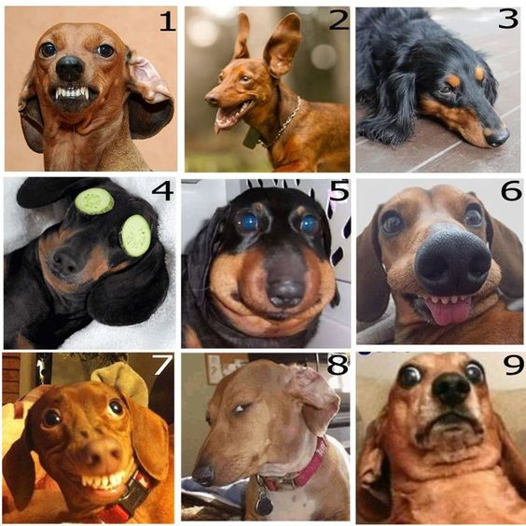
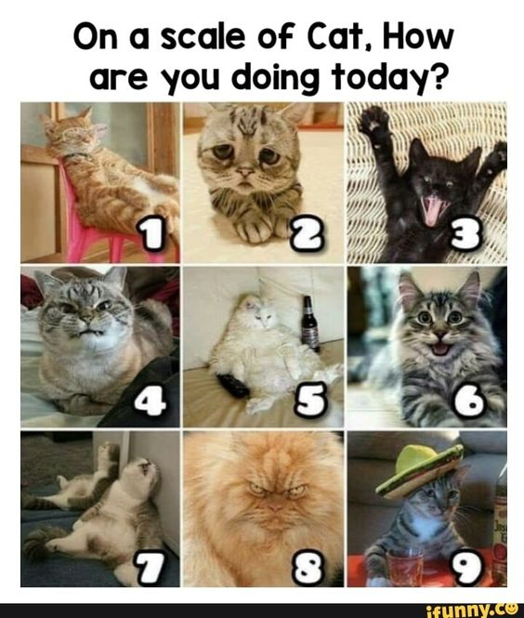

Slide 13
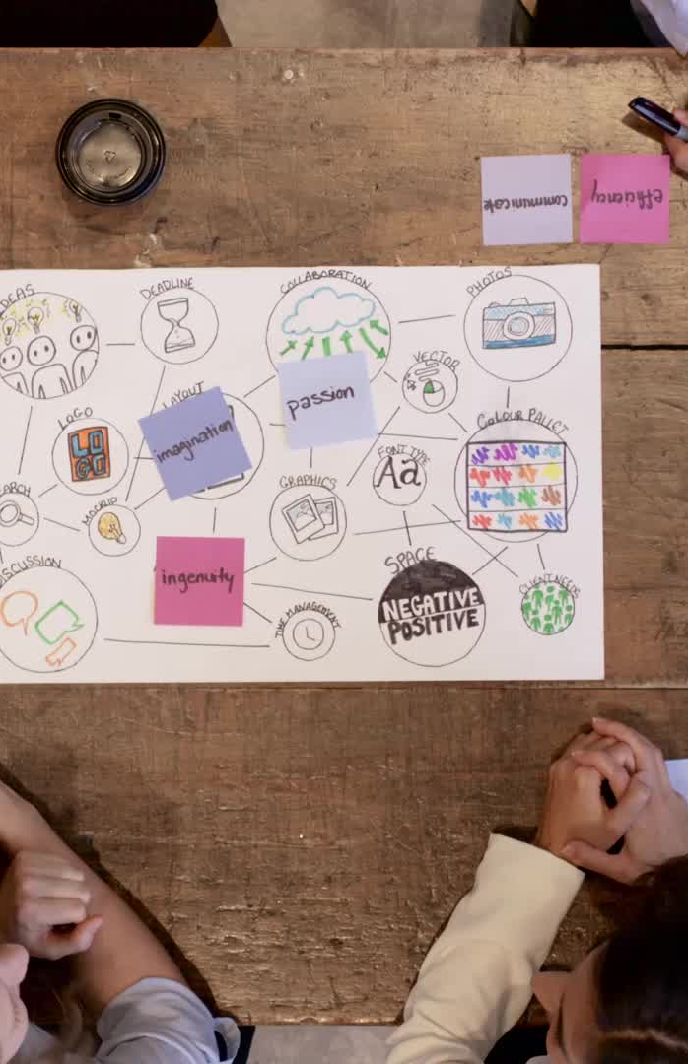
Team Building!
Everyone join a table & chooses a scribe
ROUND 1
When I yell “BEGIN,” you will go around the table each saying one word
Your scribe will write down the word you say, so speak clearly and slowly
You will do this process 2x
When done, turn the paper over
ROUND 2
2 people will change tables
When I yell “BEGIN,” you will complete ROUND 2
When finished, turn your paper upside down
Read the stories you’ve all created out loud!

Slide 14
Agenda
DAY 1
Dream Big – Create a new system
Share our ideas
Highlights of new plan vs existing system
Who do we need as partners, stakeholders and advocates?
DAY 2
Budgetary Asks or Plan
Create an advocacy plan
Wrap-up and Takeaways to move us forward

